Slide 1

Talking to Strangers:
Networking
Mykhaylo Bodnar
mykhaylo.bodnar@ualberta.ca

Slide 2
Outline
Networking
  What is networking?
Networking skills
  In person
  By phone
  In writing

Slide 3
What is networking?
VS.

Slide 4

Legit networking is simple:
“Talk shop with people who do work you want to do.”
Meaningful connections
  Ask for advice and insight
  Never ask for job leads
3 tenets to real networking
  Common ground
  Value
  Time
Nick Corcodilos, Ask The Headhunter

Slide 5
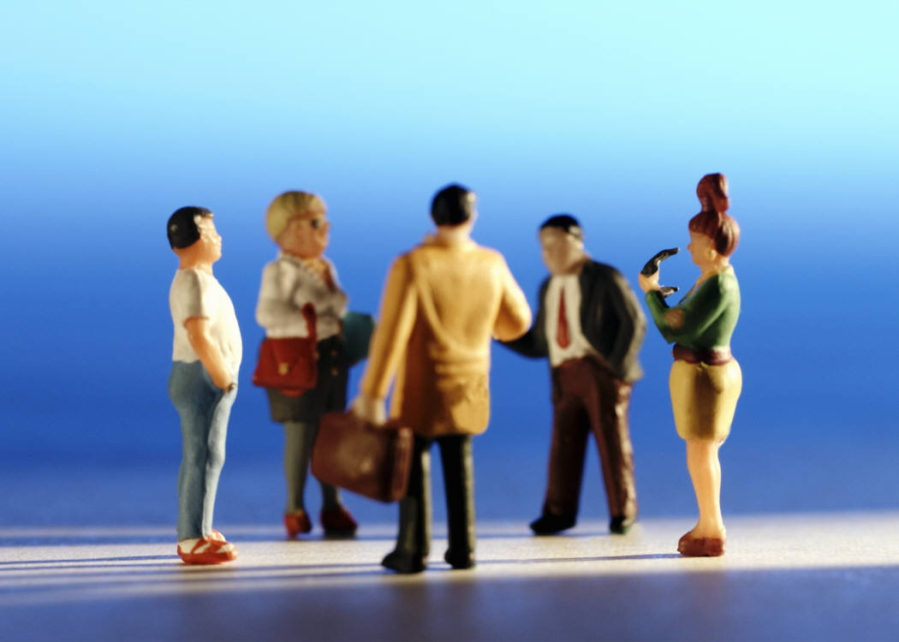
Time to circulate…
Write your work search goal on a post-it note
  People you are hoping to meet
  Information you are lacking
  Resources you are seeking

Slide 6
Benefits of networking
Gather information
Gain exposure
Get referrals
Build a support network
Help someone else
Create your own luck

Slide 7
The strength of weak ties
Strong ties
  closer to you and have your best interests at heart
  probably have access to the same people and information as you
Weak ties
  do not circulate in the same social circles
  exposed to different sources of information

Slide 8
Some ways to network
Career Information Interviews
Volunteering
Work experience – full time, part time, summer, etc.
Conferences, seminars, workshops
Student groups
Professional associations
Internships, work experience co-op experiences

Slide 9
Programs at the Career Centre
Graduate Student Internship Program
Job Shadow Week
Career Fairs and Mixers
Career Forums
Career Chats
Employer Information Sessions
U of A Career Network on LinkedIn
Career Mentoring Program

Slide 10



Networking
In Person
By Phone
In Writing

Slide 11

Networking skills
Small talk – integral part of establishing a rapport
Names
No exclamation statements
Listen with your eyes
Do your homework
Online networks
  lots of contacts vs. good contacts

Slide 12

In Person …
Dress and act professionally
Be prepared – research ahead of time
Eye contact, smile
Stick to the time you agreed upon
Focus on your skills, experience and accomplishments
Thank your contact
Follow up

Slide 13
In Writing
Gain credibility*
Be clear about who you are and your purpose
Include your contact information (not your resume)
Target & professional: write a little, say a lot
  Never say or do anything online that you wouldn’t say or do in person or over the phone
Tell when you will follow up – and follow up
* Adapted from Never Eat Alone, Keith Ferrazzi (2005)

Slide 14

By Phone
Choose a good place from which to make calls – use a script
Ask if he/she has time to speak with you
Talk a little, say a lot*
Take notes during your call – follow up
Evaluate your performance
Don’t call you best contacts first
* Adapted from Never Eat Alone, Keith Ferrazzi (2005)

Slide 15

Follow up
E-mail, thank you note
Follow up: 12 to 24 hrs.
Express your gratitude
Item of interest from your meeting or conversation
Always address it by name
Be brief and to the point
Reaffirm commitments you both made
Suggest of getting together again in the future (be specific when)
* Adapted from Never Eat Alone, Keith Ferrazzi (2005)

Slide 16
Be ready for obstacles
Receptionists
Voicemail
Rejection

Slide 17
Don’t be this person
Celebrity hound
Eye darter
Card dispenser
Adapted from Never Eat Alone, Keith Ferrazzi (2005)

Slide 18

Ability to think outside the box?
… the thread that leads most former academics to their postacademic jobs is not subject matter but skill set.
  Basalla and Debelius, So What Are You Going To Do With That?

Slide 19
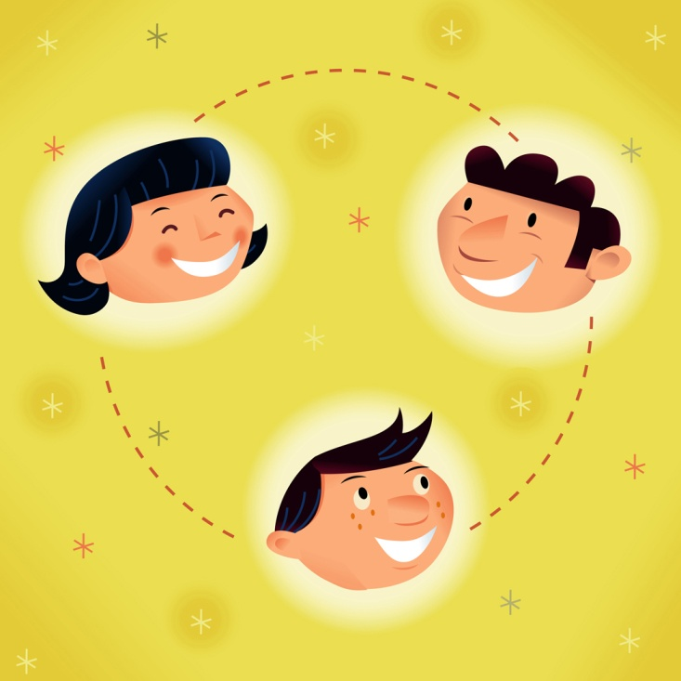
When networking, remember to…
Be authentic
Be positive
Be helpful
Focus
Follow-up

Slide 20
THANK YOU
&
GOOD LUCK!

